Slide 1
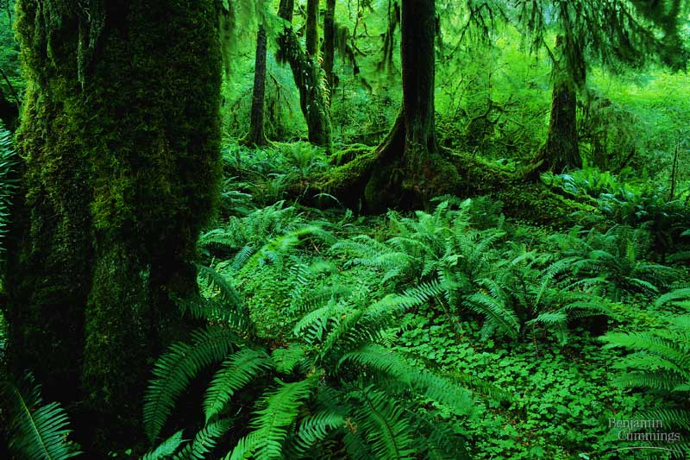
2007-2008
Notes:
‹#›

Slide 2
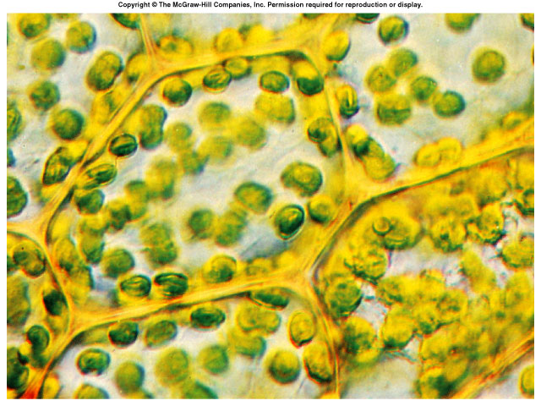
Photosynthesis: Life from Light and Air
Notes:
‹#›

Slide 3
Energy needs of life
All life needs a constant input of energy
Heterotrophs (Animals)
get their energy from “eating others”
eat food = other organisms = organic molecules
make energy through respiration
Autotrophs (Plants)
produce their own energy (from “self”)
convert energy of sunlight
build organic molecules (CHO) from CO₂
make energy & synthesize sugars through photosynthesis
consumers
producers
Notes:
‹#›

Slide 4
How are they connected?
Heterotrophs
making energy & organic molecules from ingesting organic molecules
glucose + oxygen → carbon + water +energy
dioxide
C₆H₁₂O₆
+
6O₂
→
6CO₂
+
6H₂O
+
ATP
oxidation = exergonic
Autotrophs
Where’s the ATP?
making energy & organic molecules from light energy
carbon
dioxide
+ water + energy → glucose + oxygen
6CO₂
+
6H₂O
+
light
energy
→
C₆H₁₂O₆
+
6O₂
reduction = endergonic
Notes:
‹#›
So, in effect, photosynthesis is respiration run backwards powered by light.
Cellular Respiration
oxidize C₆H₁₂O₆ → CO₂ & produce H₂O
fall of electrons downhill to O₂
exergonic
Photosynthesis
reduce CO₂ → C₆H₁₂O₆ & produce O₂
boost electrons uphill by splitting H₂O
endergonic

Slide 5
What does it mean to be a plant
Need to…
collect light energy
transform it into chemical energy
store light energy
in a stable form to be moved around the plant or stored
need to get building block atoms from the environment
C,H,O,N,P,K,S,Mg
produce all organic molecules needed for growth
carbohydrates, proteins, lipids, nucleic acids
ATP
glucose
CO₂
H₂O
N
K
P
…
Notes:
‹#›

Slide 6
1 What is the equation for cellular respiration?
2 What is the equation for photosynthesis?
3. Which of the above two requires energy (endergonic)?
4. Which of the above two releases energy (exergonic)?

Slide 7
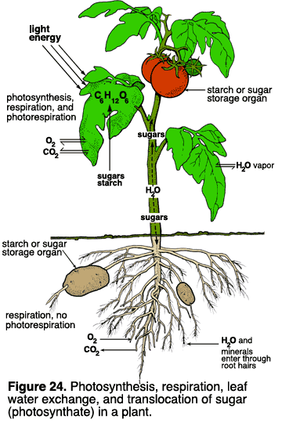
Plant structure
Obtaining raw materials
sunlight
leaves = solar collectors
CO₂
stomates = gas exchange
H₂O -xylem
uptake from roots
nutrients -phloem
N, P, K, S, Mg, Fe…
uptake from roots
Notes:
‹#›

Slide 8
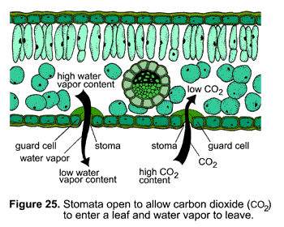
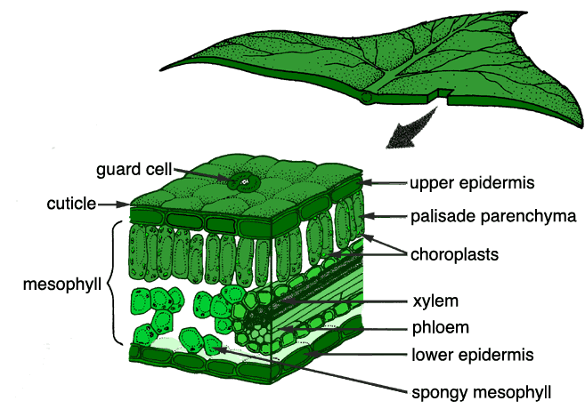
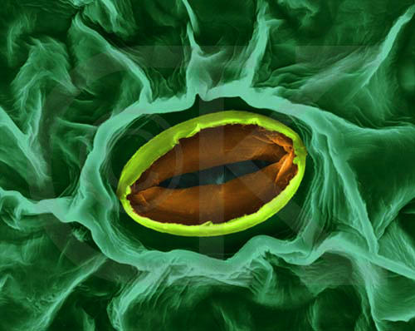
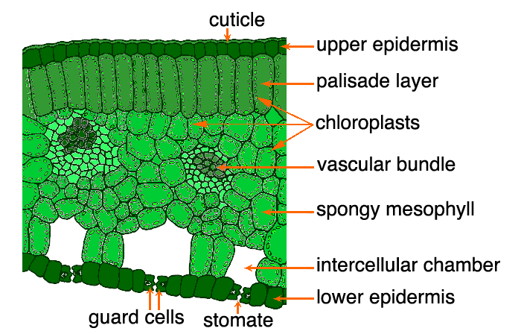
stomate
transpiration
gas exchange
Notes:
‹#›

Slide 9
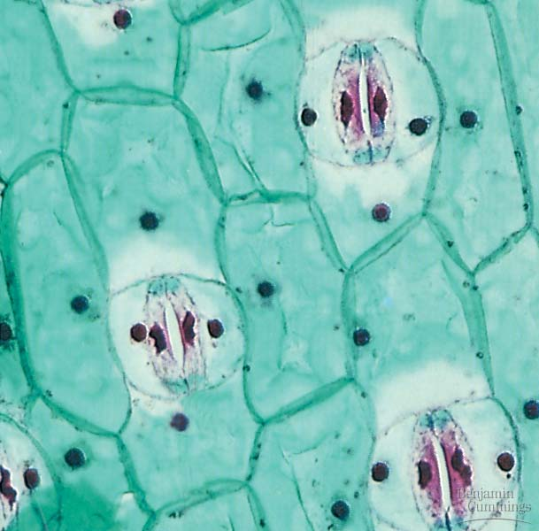
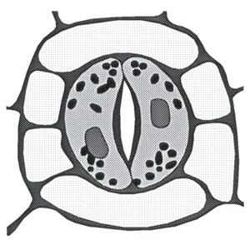
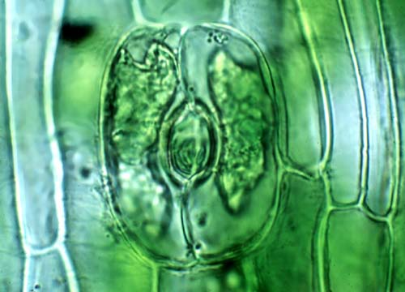
Stomates
Notes:
‹#›

Slide 10
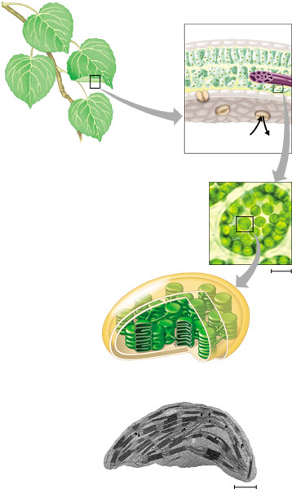
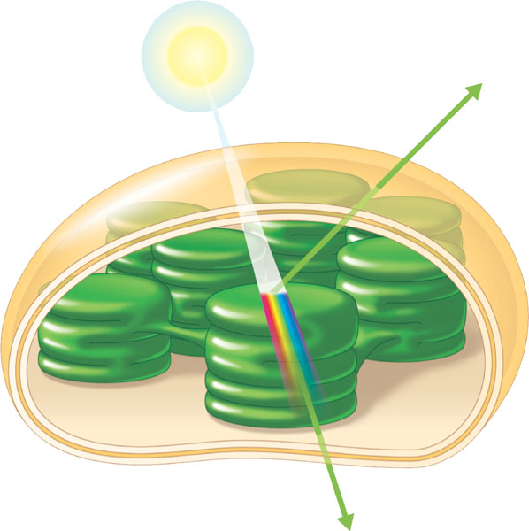
Chloroplasts
cross section of leaf
absorb sunlight & CO₂
leaves
CO₂
chloroplasts in plant cell
chloroplasts contain chlorophyll
chloroplast
make energy & sugar
Notes:
‹#›

Slide 11
Plant structure
chloroplast
H⁺
H⁺
H⁺
H⁺
H⁺
H⁺
H⁺
H⁺
H⁺
ATP
H⁺
H⁺
thylakoid
Chloroplasts
double membrane
stroma
fluid-filled interior
thylakoid
grana stacks
Thylakoid membrane contains
chlorophyll molecules
electron transport chain
ATP synthase
H⁺ gradient built up within thylakoid sac
outer membrane
inner membrane
stroma
thylakoid
granum
Notes:
‹#›
A typical mesophyll cell has 30-40 chloroplasts, each about 2-4 microns by 4-7 microns long.
Each chloroplast has two membranes around a central aqueous space, the stroma.
In the stroma are membranous sacs, the thylakoids.
These have an internal aqueous space, the thylakoid lumen or thylakoid space.
Thylakoids may be stacked into columns called grana.

Slide 12
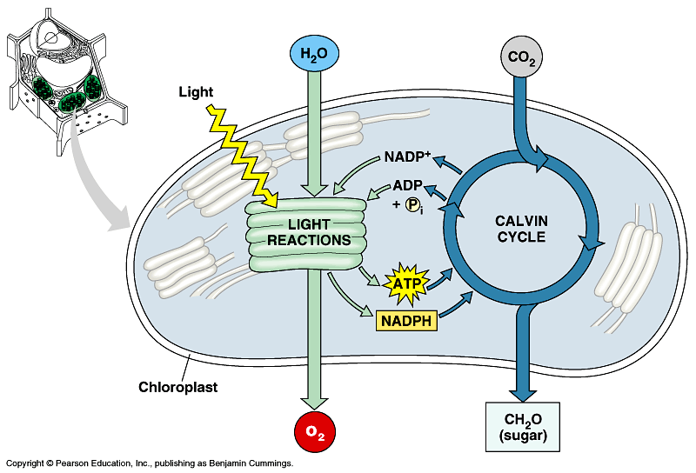
Photosynthesis
Light reactions
light-dependent reactions
energy conversion reactions
convert solar energy to chemical energy
ATP & NADPH
Calvin cycle
light-independent reactions
sugar building reactions
uses chemical energy (ATP & NADPH) to reduce CO₂ & synthesize C₆H₁₂O₆
It’s not the Dark Reactions!
Notes:
‹#›

Slide 13
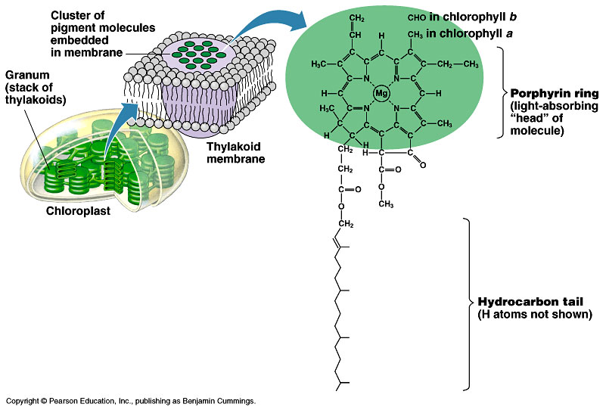
Pigments of photosynthesis
How does this molecular structure fit its function?
Chlorophylls & other pigments
embedded in thylakoid membrane
arranged in a “photosystem”
collection of molecules
structure-function relationship
Notes:
‹#›

Slide 14
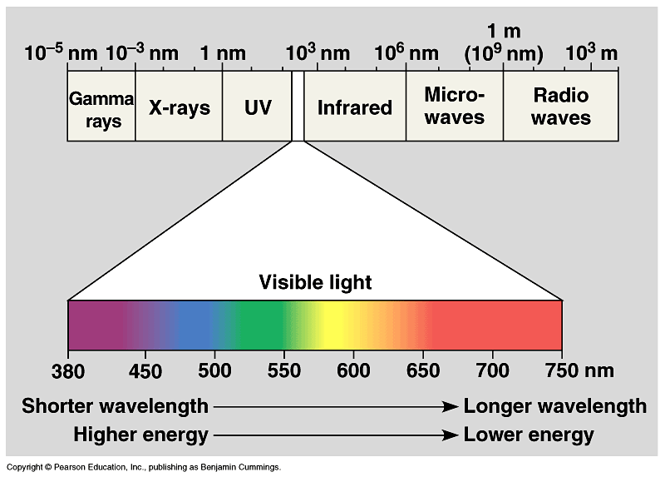
A Look at Light
The spectrum of color
V
I
B
G
Y
O
R
Notes:
‹#›

Slide 15
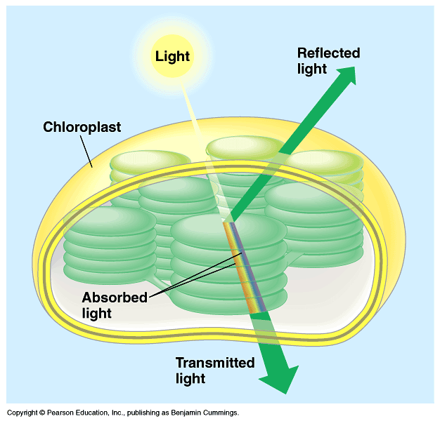
Light: absorption spectra
Photosynthesis gets energy by absorbing wavelengths of light
chlorophyll a
absorbs best in red & blue wavelengths & least in green
accessory pigments with different structures absorb light of different wavelengths
chlorophyll b, carotenoids, xanthophylls
Why are plants green?
Notes:
‹#›

Slide 16
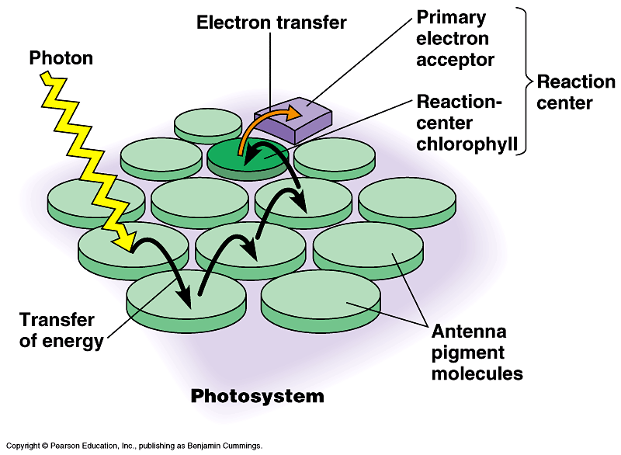
Photosystems of photosynthesis
2 photosystems in thylakoid membrane
collections of chlorophyll molecules
act as light-gathering molecules
Photosystem II
chlorophyll a
P₆₈₀ = absorbs 680nm wavelength red light
Photosystem I
chlorophyll b
P₇₀₀ = absorbs 700nm wavelength red light
reaction center
antenna pigments
Notes:
‹#›
Photons are absorbed by clusters of pigment molecules (antenna molecules) in the thylakoid membrane.
When any antenna molecule absorbs a photon, it is transmitted from molecule to molecule until it reaches a particular chlorophyll a molecule = the reaction center.
At the reaction center is a primary electron acceptor which removes an excited electron from the reaction center chlorophyll a.
This starts the light reactions.
Don’t compete with each other, work synergistically using different wavelengths.

Slide 17
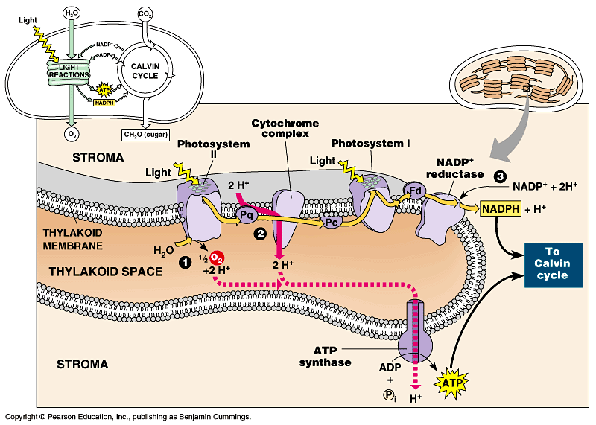
ETC of Photosynthesis
chlorophyll a
Photosystem II
chlorophyll b
Photosystem I
Notes:
‹#›
Two places where light comes in.
Remember photosynthesis is endergonic -- the electron transport chain is driven by light energy.
Need to look at that in more detail on next slide

Slide 18
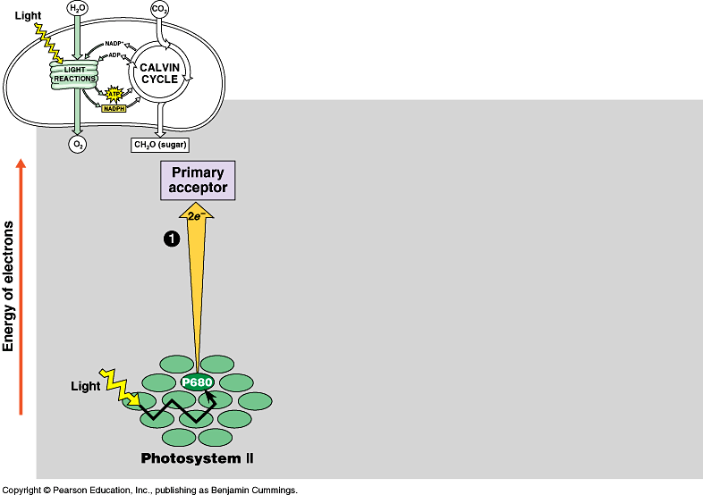
ETC of Photosynthesis
http://ed.ted.com/on/yyPK0Q8H
sun
1
e
e
Photosystem II P680 chlorophyll a
Notes:
‹#›
PS II absorbs light
Excited electron passes from chlorophyll to the primary electron acceptor
Need to replace electron in chlorophyll
An enzyme extracts electrons from H₂O & supplies them to the chlorophyll
This reaction splits H₂O into 2 H⁺ & O⁻ which combines with another O⁻ to form O₂
O₂ released to atmosphere
Chlorophyll absorbs light energy (photon) and this moves an electron to a higher energy state
Electron is handed off down chain from electron acceptor to electron acceptor
In process has collected H⁺ ions from H₂O & also pumped by Plastoquinone within thylakoid sac.
Flow back through ATP synthase to generate ATP.

Slide 19
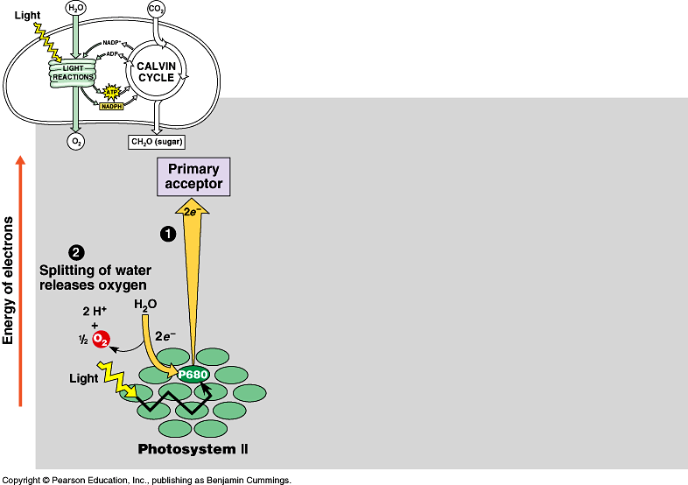
Inhale, baby!
ETC of Photosynthesis
chloroplast
thylakoid
H⁺
H⁺
H⁺
H⁺
H⁺
H⁺
H⁺
H⁺
H⁺
H⁺
H⁺
H⁺
H⁺
H⁺
H⁺
H⁺
ATP
H⁺
H⁺
H⁺
H⁺
H⁺
H⁺
Plants SPLIT water!
1
H
H
2
O
e
e
O
H
H
O
e⁻
H⁺
+H
e⁻
e
e
fill the e– vacancy
Photosystem II P680 chlorophyll a
Notes:
‹#›

Slide 20
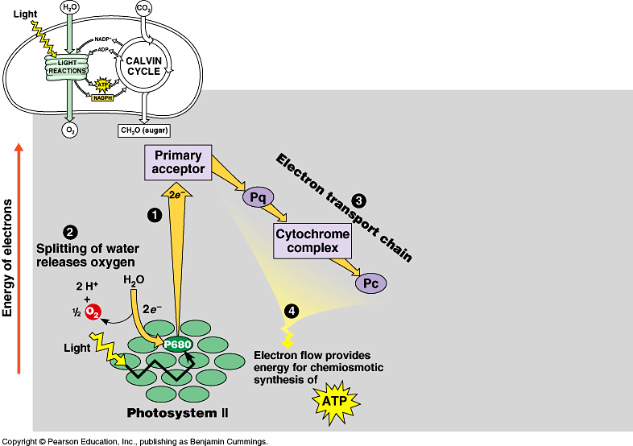
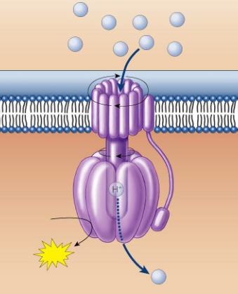
ETC of Photosynthesis
chloroplast
thylakoid
H⁺
H⁺
H⁺
H⁺
H⁺
H⁺
H⁺
H⁺
H⁺
H⁺
H⁺
H⁺
H⁺
H⁺
H⁺
H⁺
ATP
H⁺
H⁺
H⁺
H⁺
H⁺
H⁺
e
e
3
1
2
H⁺
e
e
ATP
4
H⁺
to Calvin Cycle
H⁺
H⁺
H⁺
H⁺
H⁺
H⁺
H⁺
H⁺
energy to build carbohydrates
Photosystem II P680 chlorophyll a
ATP
ADP + P_{i}
H⁺
Notes:
‹#›

Slide 21
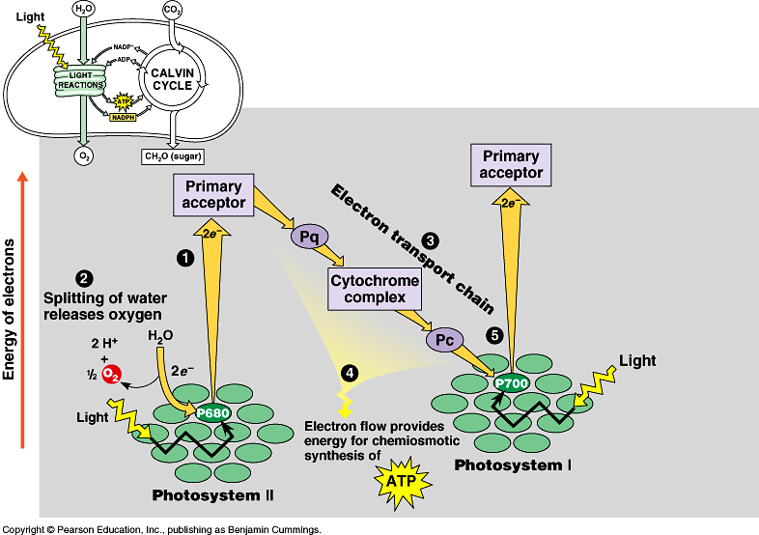
ETC of Photosynthesis
e
e
e
sun
e
fill the e– vacancy
e
5
e
e
e
Photosystem I P700 chlorophyll b
Photosystem II P680 chlorophyll a
Notes:
‹#›
Need a 2nd photon -- shot of light energy to excite electron back up to high energy state.
2nd ETC drives reduction of NADP to NADPH.
Light comes in at 2 points.
Produce ATP & NADPH

Slide 22
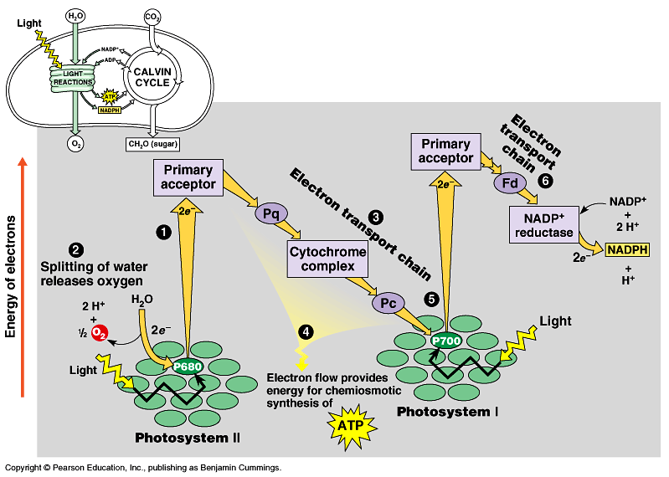
ETC of Photosynthesis
electron carrier
e
e
6
e
e
5
sun
NADPH to Calvin Cycle
Photosystem I P700 chlorophyll b
Photosystem II P680 chlorophyll a
$$ in the bank… reducing power!
Notes:
‹#›
Need a 2nd photon -- shot of light energy to excite electron back up to high energy state.
2nd ETC drives reduction of NADP to NADPH.
Light comes in at 2 points.
Produce ATP & NADPH

Slide 23
ETC of Photosynthesis
sun
sun
e
e
e
e
H⁺
H⁺
H⁺
O
H⁺
H⁺
H⁺
H⁺
H⁺
to Calvin Cycle
H⁺
H⁺
H⁺
split H₂O
ATP
Notes:
‹#›
Two places where light comes in.
Remember photosynthesis is endergonic -- the electron transport chain is driven by light energy.
Need to look at that in more detail on next slide

Slide 24
ETC of Photosynthesis
ETC uses light energy to produce
ATP & NADPH
go to Calvin cycle
PS II absorbs light
excited electron passes from chlorophyll to “primary electron acceptor”
need to replace electron in chlorophyll
enzyme extracts electrons from H₂O & supplies them to chlorophyll
splits H₂O
O combines with another O to form O₂
O₂ released to atmosphere
and we breathe easier!
Notes:
‹#›

Slide 25
Experimental evidence
Where did the O₂ come from?
radioactive tracer = O₁₈
Experiment 1
light
energy
→
6CO₂
+
6H₂O
+
light
energy
→
+
6O₂
6CO₂
+
6H₂O
+
C₆H₁₂O₆
+
6O₂
C₆H₁₂O₆
Experiment 2
6CO₂
+
6H₂O
+
light
energy
→
C₆H₁₂O₆
+
6O₂
Proved O₂ came from H₂O not CO₂ = plants split H₂O!
Notes:
‹#›

Slide 26
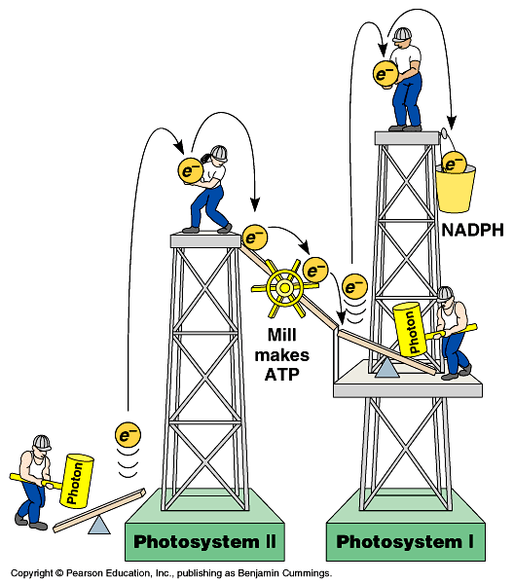
Noncyclic Photophosphorylation
Light reactions elevate electrons in 2 steps (PS II & PS I) ** Any time you make NADPH
PS II generates energy as ATP
PS I generates reducing power as NADPH
ATP
Notes:
‹#›
1 photosystem is not enough.
Have to lift electron in 2 stages to a higher energy level. Does work as it falls.
First, produce ATP -- but producing ATP is not enough.
Second, need to produce organic molecules for other uses & also need to produce a stable storage molecule for a rainy day (sugars). This is done in Calvin Cycle!

Slide 27
Cyclic photophosphorylation
If PS I can’t pass electron to NADP…it cycles back to PS II & makes more ATP, but no NADPH
coordinates light reactions to Calvin cycle
Calvin cycle uses more ATP than NADPH

ATP
18 ATP + 12 NADPH
→
1 C₆H₁₂O₆
Notes:
‹#›

Slide 28
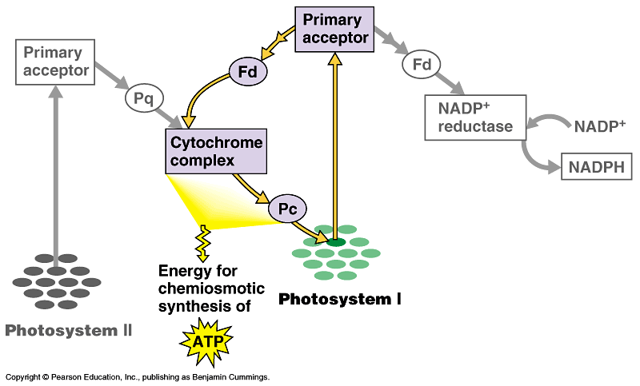
Photophosphorylation
cyclic
photophosphorylation
NADP
NONcyclic
photophosphorylation
ATP
Notes:
‹#›

Slide 29
Photosynthesis summary
Where did the energy come from?
Where did the electrons come from?
Where did the H₂O come from?
Where did the O₂ come from?
Where did the O₂ go?
Where did the H⁺ come from?
Where did the ATP come from?
What will the ATP be used for?
Where did the NADPH come from?
What will the NADPH be used for?
…stay tuned for the Calvin cycle
Notes:
‹#›
Where did the energy come from? The Sun
Where did the electrons come from? Chlorophyll
Where did the H₂O come from?
The ground through the roots/xylem
Where did the O₂ come from? The splitting of water
Where did the O₂ go? Out stomates to air
Where did the H⁺ come from? The slitting of water
Where did the ATP come from?
Photosystem 2: Chemiosmosis (H+ gradient)
What will the ATP be used for?
The work of plant life! Building sugars
Where did the NADPH come from?
Reduction of NADP (Photosystem 1)
What will the NADPH be used for? Calvin cycle / Carbon fixation

Slide 30
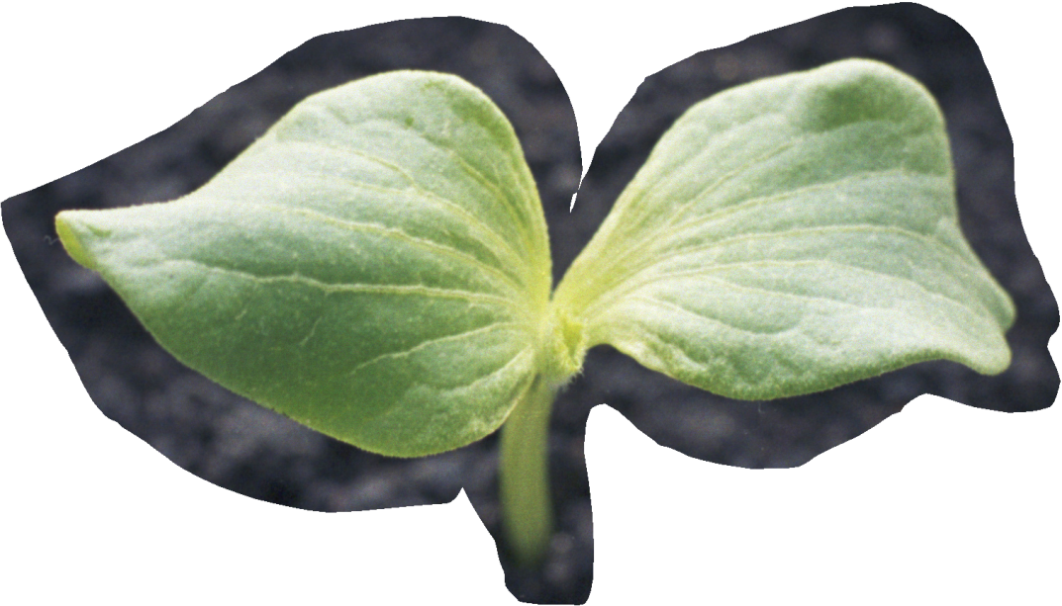
You can grow if you Ask Questions!
Notes:
‹#›

Slide 31
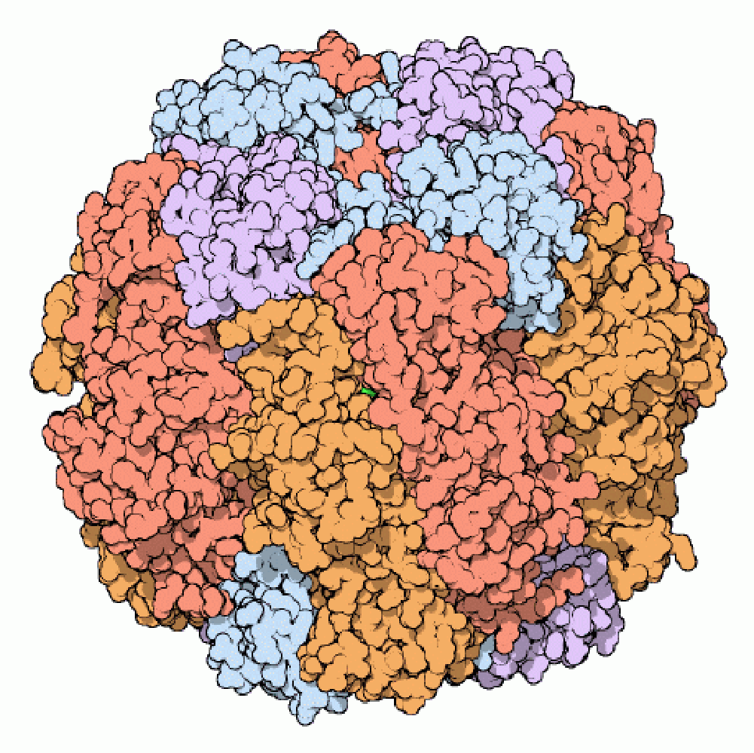
Photosynthesis: The Calvin Cycle Life from Air
2007-2008
Notes:
‹#›

Slide 32
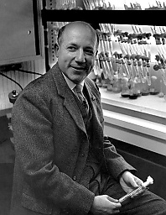
The Calvin Cycle
1950s | 1961
Whoops! Wrong Calvin…
Notes:
‹#›

Slide 33
Remember what it means to be a plant…
Need to produce all organic molecules necessary for growth
carbohydrates, lipids, proteins, nucleic acids
Need to store chemical energy (ATP) produced from light reactions
in a more stable form
that can be moved around plant
saved for a rainy day
carbon
dioxide
+ water + energy → glucose + oxygen
6CO₂
+
6H₂O
+
light
energy
→
C₆H₁₂O₆
+
6O₂
Notes:
‹#›

Slide 34
Light reactions
Convert solar energy to chemical energy
ATP
NADPH
What can we do now?
ATP
→ energy
→ reducing power
→ → build stuff !!
photosynthesis
Notes:
‹#›

Slide 35
How is that helpful?
http://ed.ted.com/lessons/nature-s-smallest-factory-the-calvin-cycle-cathy-symington#review
Want to make C₆H₁₂O₆
synthesis
How? From what? What raw materials are available?
CO₂
NADPH
reduces CO₂
carbon fixation
NADP
C₆H₁₂O₆
NADP
Notes:
‹#›
CO₂ contains little energy because it is fully oxidized
Reduce CO₂ in a series of steps to synthesize a stable energy storage molecule

Slide 36
From CO₂ → C₆H₁₂O₆
CO₂ has very little chemical energy
fully oxidized
C₆H₁₂O₆ contains a lot of chemical energy
highly reduced
Synthesis = endergonic process
put in a lot of energy
Reduction of CO₂ → C₆H₁₂O₆ proceeds in many small uphill steps
each catalyzed by a specific enzyme
using energy stored in ATP & NADPH
Notes:
‹#›

Slide 37
From Light reactions to Calvin cycle
Calvin cycle
chloroplast stroma
Need products of light reactions to drive synthesis reactions
ATP
NADPH
stroma
ATP
thylakoid
Notes:
‹#›

Slide 38
accounting
12H2O + 12NADP + 18ADP → 6O2 + 12NADPH + 18ATP.
Answer = 18. This is enough to make one glucose (see below)-
Calvin CYCLE
6CO2 + 12NADPH + 18ATP → C6H12O6 + 12NADP + 18ADP + 6H2O

Slide 39
C
C
Calvin cycle
C
C
C
C
C
C
1C
CO₂
C
C
C
C
C
1. Carbon fixation
3. Regeneration of RuBP
C
C
C
C
C
5C
C
C
C
C
C
C
RuBP
RuBisCo
ribulose bisphosphate
C
C
C
C
C
C
starch, sucrose, cellulose & more
6C
3 ATP
ribulose bisphosphate carboxylase
C
C
C
C
C
C
3 ADP
5C
C
C
C
used
to make glucose
C
C
C
glyceraldehyde-3-P
3C
C
C
C
G3P
PGA
C
C
C
C
C
C
C
C
C
phosphoglycerate
C
C
C
3C
C
=
C
=
C
C
C
C
C
C
C
C
C
C
6 ATP
C
C
C
2. Reduction
H
H
H
6 NADPH
6 ADP
|
–
|
–
|
C
C
C
3C
C
C
C
H
H
H
C
C
C
6 NADP
|
|
|
Notes:
‹#›
1. A five-carbon sugar molecule called ribulose bisphosphate, or RuBP, is the acceptor that binds CO2 dissolved in the stroma. This process, called CO2 fixation, is catalyzed by the enzyme RuBP carboxylase, forming an unstable six-carbon molecule. This molecule quickly breaks down to give two molecules of the three-carbon 3-phosphoglycerate (3PG), also called phosphoglyceric acid (PGA).
2. The two 3PG molecules are converted into glyceraldehyde 3-phosphate (G3P, a.k.a. phosphoglyceraldehyde, PGAL) molecules, a three-carbon sugar phosphate, by adding a high-energy phosphate group from ATP, then breaking the phosphate bond and adding hydrogen from NADH + H+.
3. Three turns of the cycle, using three molecules of CO2, produces six molecules of G3P. However, only one of the six molecules exits the cycle as an output, while the remaining five enter a complex process that regenerates more RuBP to continue the cycle. Two molecules of G3P, produced by a total of six turns of the cycle, combine to form one molecule of glucose.

Slide 40
Please Remember G3P?
glucose
C-C-C-C-C-C
ATP
2
2
ADP
glycolysis
fructose-1,6bP
P-C-C-C-C-C-C-P
glyceraldehyde 3-phosphate
DHAP
P-C-C-C
G3P
C-C-C-P
2
NAD⁺
2
4
ADP
ATP
4
Photosynthesis
pyruvate
C-C-C
Notes:
‹#›
Gluconeogenesis == making new glucose

Slide 41
To G3P and Beyond!
To G3P and beyond!
Glyceraldehyde-3-P
end product of Calvin cycle
energy rich 3 carbon sugar
“C3 photosynthesis”
G3P is an important intermediate
G3P → → glucose → → carbohydrates
→ → lipids → → phospholipids, fats, waxes
→ → amino acids → → proteins
→ → nucleic acids → → DNA, RNA
Notes:
‹#›

Slide 42
RuBisCo
Enzyme which fixes carbon from air
ribulose bisphosphate carboxylase
the most important enzyme in the world!
it makes life out of air!
definitely the most abundant enzyme
I’m green with envy!
It’s not easy being green!
Notes:
‹#›

Slide 43
Accounting
The accounting is complicated
3 turns of Calvin cycle = 1 G3P
3 CO₂ → 1 G3P (3C)
6 turns of Calvin cycle = 1 C₆H₁₂O₆ (6C)
6 CO₂ → 1 C₆H₁₂O₆ (6C)
18 ATP + 12 NADPH → 1 C₆H₁₂O₆
any ATP left over from light reactions will be used elsewhere by the cell
Notes:
‹#›

Slide 44
Photosynthesis summary
Light reactions
produced ATP
produced NADPH
consumed H₂O
produced O₂ as byproduct
Calvin cycle
consumed CO₂
produced G3P (sugar)
regenerated ADP
regenerated NADP
ADP
NADP
Notes:
‹#›

Slide 45
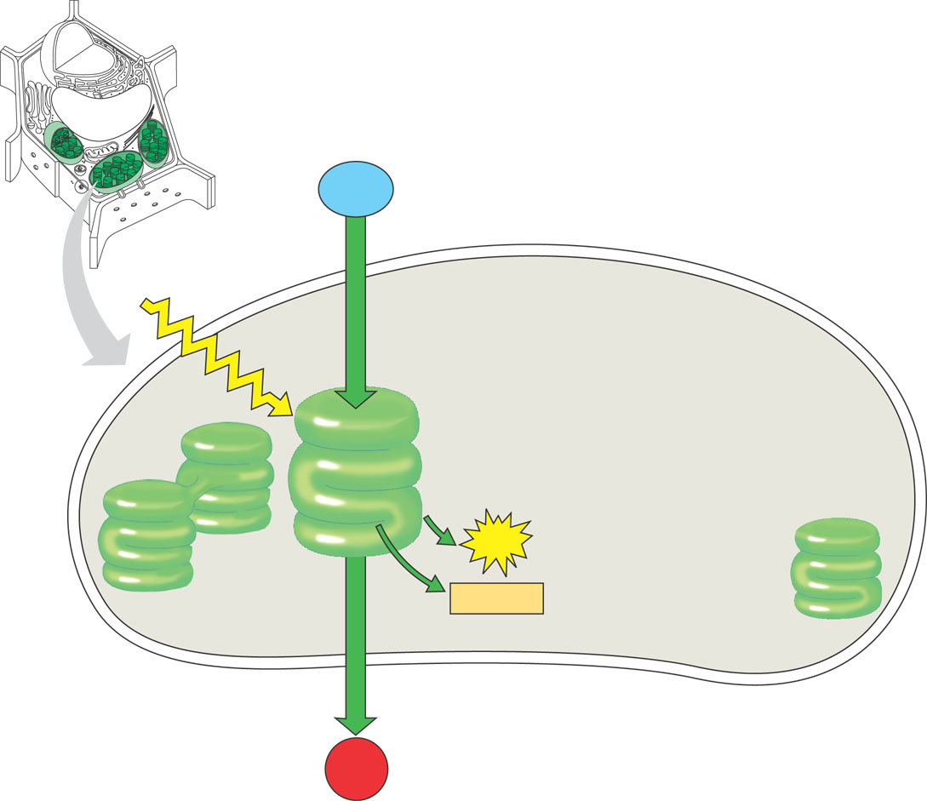
Light Reactions
H₂O
+
light
energy
→
ATP
+
NADPH
+
O₂
H₂O
produces ATP
produces NADPH
releases O₂ as a waste product
sunlight
Energy Building
Reactions
NADPH
ATP
O₂
Notes:
‹#›

Slide 46
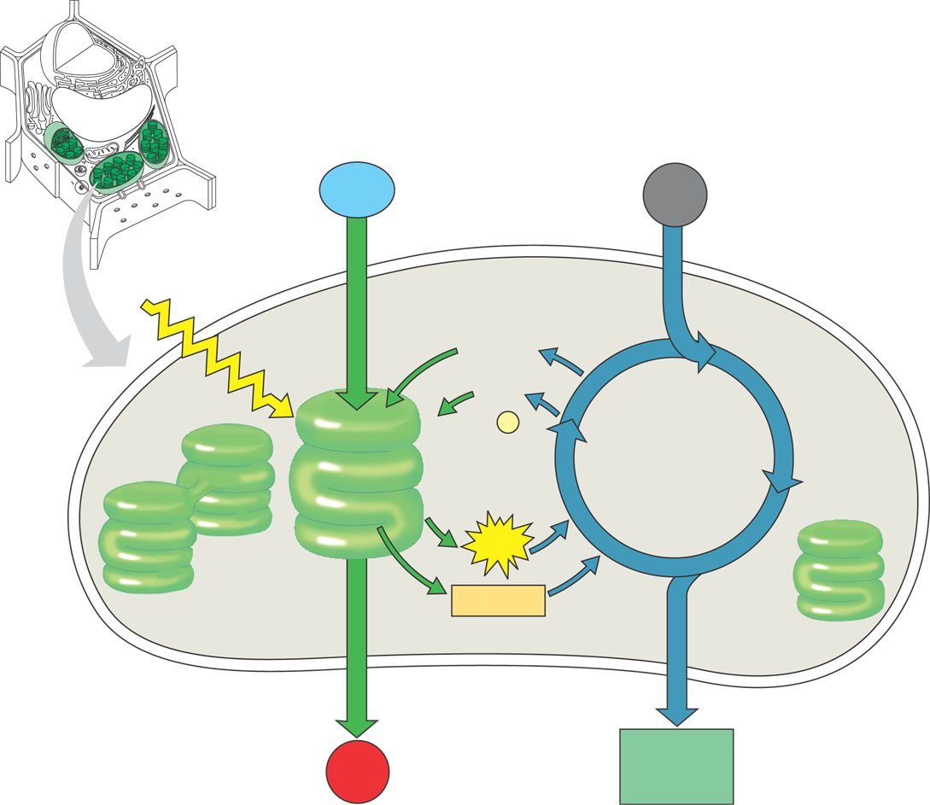
Calvin Cycle
CO₂
+
ATP
+
NADPH
→
C₆H₁₂O₆
+
ADP
+
NADP
CO₂
builds sugars
uses ATP & NADPH
recycles ADP & NADP
back to make more ATP & NADPH
ADP
NADP
Sugar Building
Reactions
NADPH
ATP
sugars
Notes:
‹#›

Slide 47
Putting it all together
CO₂
+
H₂O
+
light
energy
→
C₆H₁₂O₆
+
O₂
H₂O
CO₂
Plants make both:
energy
ATP & NADPH
sugars
sunlight
ADP
Energy Building
Reactions
NADP
Sugar Building
Reactions
NADPH
ATP
O₂
sugars
Notes:
‹#›

Slide 48
Energy cycle
even though this equation is a bit of a lie… it makes a
better story
sun
Photosynthesis
CO₂
+
H₂O
+
light
energy
→
C₆H₁₂O₆
+
O₂
plants
CO₂
H₂O
glucose
O₂
animals, plants
C₆H₁₂O₆
+
O₂
→
ATP
energy
+
CO₂
+
H₂O
Cellular Respiration
ATP
The Great Circle of Life,Mufasa!
Notes:
‹#›

Slide 49
Summary of photosynthesis
6CO₂
+
6H₂O
+
light
energy
→
C₆H₁₂O₆
+
6O₂
Where did the CO₂ come from?
Where did the CO₂ go?
Where did the H₂O come from?
Where did the H₂O go?
Where did the energy come from?
What’s the energy used for?
What will the C₆H₁₂O₆ be used for?
Where did the O₂ come from?
Where will the O₂ go?
What else is involved…not listed in this equation?
Notes:
‹#›
Where did the CO₂ come from? air
Where did the CO₂ go? carbohydrate (G3P)
Where did the H₂O come from? soil (xylem)
Where did the H₂O go? split to donate e- & H+
Where did the energy come from? sun
What’s the energy used for? to make ATP in light reactions
What will the C₆H₁₂O₆ be used for? the work of plant life
Where did the O₂ come from? splitting of H₂O
Where will the O₂ go? air or respiration
What else is involved…not listed in this equation?
ATP, ADP, NADP, NADPH

Slide 50
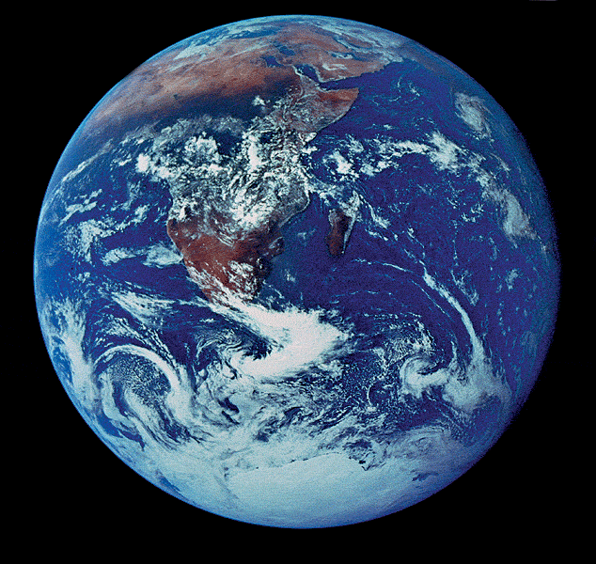
Supporting a biosphere
On global scale, photosynthesis is the most important process for the continuation of life on Earth
each year photosynthesis…
captures 121 billion tons of CO₂
synthesizes 160 billion tons of carbohydrate
heterotrophs are dependent on plants as food source for fuel & raw materials
Notes:
‹#›

Slide 51
The poetic perspective…
All the solid material of every plant was built by sunlight out of thin air
All the solid material of every animal was built from plant material
sun
air
Then all the plants, cats, dogs, elephants & people … are really particles of air woven together by strands of sunlight!
Notes:
‹#›

Slide 52
If plants can do it… You can learn it!
Ask Questions!!
2007-2008
Notes:
‹#›

Slide 53
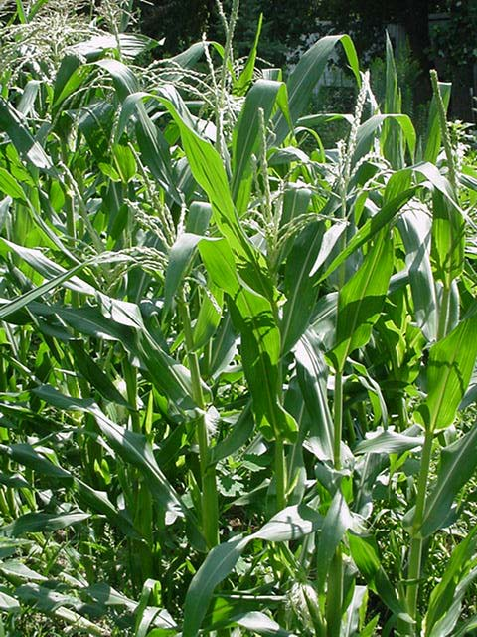
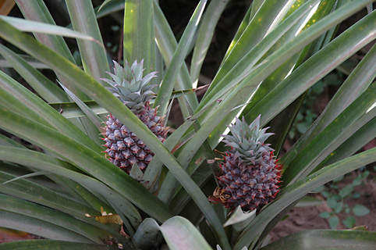
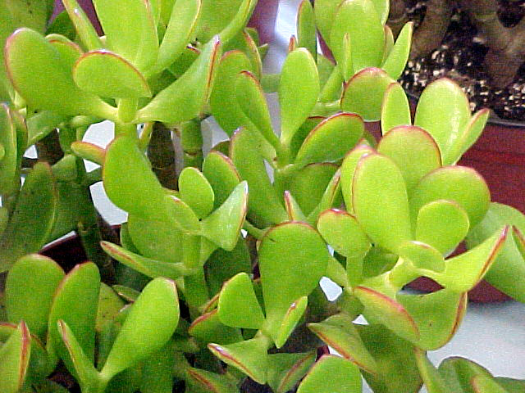
Photosynthesis: Variations on the Theme
2007-2008
Notes:
‹#›

Slide 54
Remember what plants need…
Photosynthesis
light reactions
light
H₂O
Calvin cycle
CO₂
O
← sun
C
O
← ground
← air
What structures have plants evolved to supply these needs?
Notes:
‹#›

Slide 55
Leaf Structure
vascular bundle
xylem (water)
cuticle
phloem (sugar)
epidermis
palisades
layer
O₂
H₂O
spongy
layer
CO₂
stomate
guard cell
Transpiration
O₂
H₂O
CO₂
Gas exchange
Notes:
‹#›

Slide 56
A second look inside a leaf…
Gas exchange & water flow
CO₂ in →
O₂ out →
H₂O out →
for Calvin cycle
waste from light reactions
for light reactions
photosynthesis
xylem (water)
O₂
CO₂
phloem (sugars)
gas exchange water loss
H₂O
O₂
CO₂
Notes:
‹#›

Slide 57
Controlling water loss from leaves
Hot or dry days
stomates close to conserve water
guard cells
gain H₂O = stomates open
lose H₂O = stomates close
adaptation to living on land, but…
creates PROBLEMS!
Notes:
‹#›
On sunny hot days, balancing 2 processes/ 2 forces:
Lots of sun so guard cells producing glucose, therefore increasing sugar concentration, therefore increase osmosis into guard cells = turgid & open
Lots of sun so plant starts to wilt, therefore guard cells shrink = flaccid & closed

Slide 58
When stomates close…
Closed stomates lead to…
O₂ build up → from light reactions
CO₂ is depleted → in Calvin cycle
causes problems in Calvin Cycle
The best laid schemes of mice and men… and plants!
O₂
xylem (water)
phloem (sugars)


CO₂
O₂
CO₂
H₂O
Notes:
‹#›

Slide 59
Inefficiency of RuBisCo: CO₂ vs O₂
RuBisCo in Calvin cycle
carbon fixation enzyme
normally bonds C to RuBP
CO₂ is the optimal substrate
reduction of RuBP
building sugars
when O₂ concentration is high
RuBisCo bonds O to RuBP
O₂ is a competitive substrate
oxidation of RuBP
breakdown sugars
photosynthesis
photorespiration
Notes:
‹#›

Slide 60
Calvin cycle when CO₂ is abundant
1C
CO₂
RuBP
ATP
5C
RuBisCo
unstable
intermediate
ADP
6C
G3P
to make
glucose
5C
C3 plants
PGA
3C
G3P
3C
NADPH
ATP
NADP
ADP
3C
Notes:
‹#›

Slide 61
Calvin cycle when O₂ is high
to mitochondria
–––––––
lost as CO₂ without making ATP
O₂
RuBP
5C
Hey Dude,
are you high on oxygen!
RuBisCo
2C
3C
It’s so sad to see a good enzyme, go BAD!
photorespiration
Notes:
‹#›

Slide 62
Impact of Photorespiration
Oxidation of RuBP
short circuit of Calvin cycle
loss of carbons to CO₂
can lose 50% of carbons fixed by Calvin cycle
reduces production of photosynthesis
no ATP (energy) produced
no C₆H₁₂O₆ (food) produced
if photorespiration could be reduced, plant would become 50% more efficient
strong selection pressure to evolve alternative carbon fixation systems
Notes:
‹#›

Slide 63
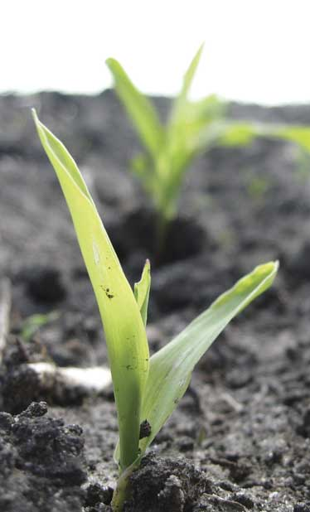
Reducing photorespiration
Separate carbon fixation from Calvin cycle
C4 plants
PHYSICALLY separate carbon fixation from Calvin cycle
different cells to fix carbon vs. where Calvin cycle occurs
store carbon in 4C compounds
different enzyme to capture CO₂ (fix carbon)
PEP carboxylase
different leaf structure
CAM plants
separate carbon fixation from Calvin cycle by TIME OF DAY
fix carbon during night
store carbon in 4C compounds
perform Calvin cycle during day
Notes:
‹#›
The key point is how carbon dioxide is grabbed out of the air -- carbon fixation -- and then handed off to the Calvin cycle.
C4 plants separate the 2 steps of carbon fixation anatomically. They use 2 different cells to complete the process.
CAM plants separate the 2 steps of carbon fixation temporally. They do them at 2 different times.
The key problem they are trying to overcome is that Rubisco is a very inefficient enzyme in the presence of high O2. In high O2, Rubisco bonds oxygen to RuBP rather than carbon, so the plants have to keep O2 away from Rubsico.
C4 & CAM should be seen as variations on *carbon fixation*, because plants had to evolve alternative systems given the limitations of their enzymes and their need to conserve water.

Slide 64
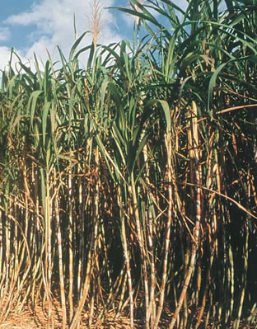
C4 plants
A better way to capture CO₂
1st step before Calvin cycle, fix carbon with enzyme PEP carboxylase
store as 4C compound
adaptation to hot, dry climates
have to close stomates a lot
different leaf anatomy
sugar cane, corn, other grasses…
corn
sugar cane
Notes:
‹#›

Slide 65
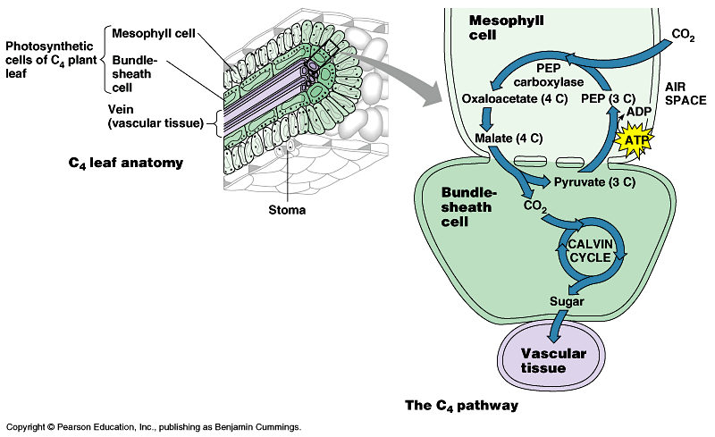
C4 leaf anatomy
PEP (3C) + CO₂ → oxaloacetate (4C)
O₂
light reactions
CO₂
PEP carboxylase
C3 anatomy
bundle sheath cell
stomate
CO₂
PEP carboxylase enzyme
higher attraction for CO₂ than O₂
better than RuBisCo
fixes CO₂ in 4C compounds
regenerates CO₂ in inner cells for RuBisCo
keeping O₂ away from RuBisCo
RuBisCo
C4 anatomy
Notes:
‹#›
PEP = phosphoenolpyruvate
C4 plants solve the photorespiration problem by fixing carbon in outer ring of mesophyll cells using a different enzyme -- PEP carboxylase -- which has a higher affinity for CO2 than O2 (better than Rubisco), so it fixes CO2 in 4C "storage" compounds (oxaloacetate, malate). It then passes the carbon on by regenerating CO2 in the inner bundle sheath cells for Rubisco to use in the Calvin cycle.

Slide 66
C4 photosynthesis
PHYSICALLY separated C fixation from Calvin cycle
Outer cells
light reaction & carbon fixation
pumps CO₂ to inner cells
keeps O₂ away from inner cells
away from RuBisCo
Inner cells
Calvin cycle
glucose to veins
CO₂
O₂
O₂
CO₂
Notes:
‹#›

Slide 67
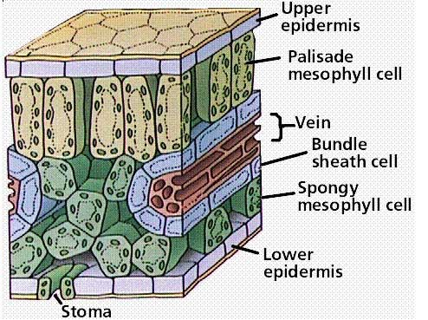
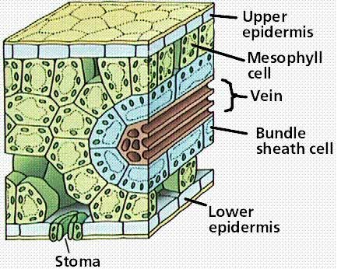
Comparative anatomy
Location, location,location!
C3
C4
PHYSICALLY separate C fixation from Calvin cycle
Notes:
‹#›

Slide 68
CAM (Crassulacean Acid Metabolism) plants
Adaptation to hot, dry climates
separate carbon fixation from Calvin cycle by TIME
close stomates during day
open stomates during night
at night: open stomates & fix carbon in 4C “storage” compounds
in day: release CO₂ from 4C acids to Calvin cycle
increases concentration of CO₂ in cells
succulents, some cacti, pineapple
It’s all in the timing!
Notes:
‹#›
Crassulacean Acid Metabolism (CAM)
Succulents are in the family Crassulaceae
the name Crassula is derived from the Latin "crassus" meaning thick and refers to the leaves of these succulent plants
CAM plants solve the photorespiration problem by fixing carbon at night (when stomates are open), and put it in "storage" compounds (organic acids like malic acid, isocitric acid) and then in the day (when stomates are closed), they release the CO2 from the "storage" compounds to the Calvin cycle
(thereby increasing CO2 in the cells, improving Rubisco's efficiency)

Slide 69
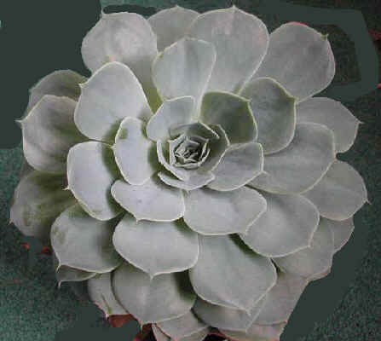
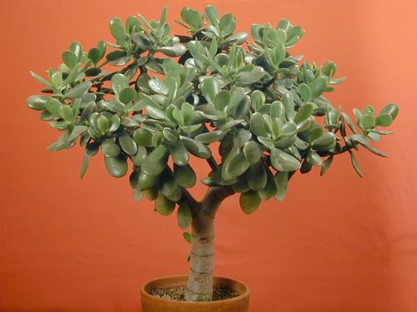
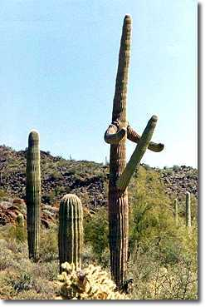
CAM plants
cacti
succulents
pineapple
Notes:
‹#›

Slide 70
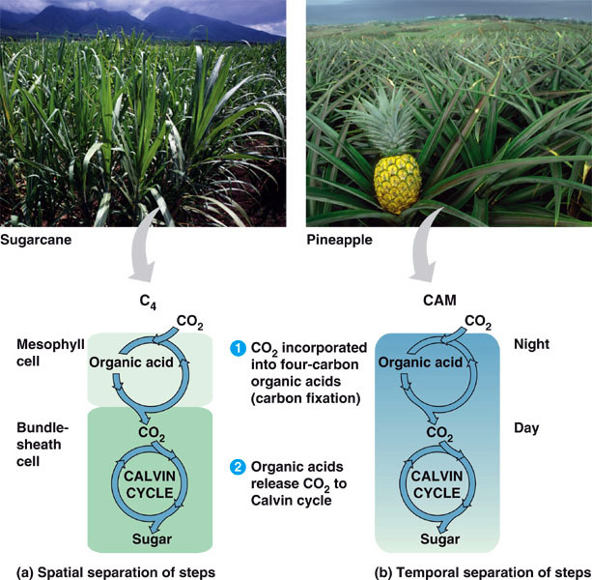
C4 vs CAM Summary
solves CO₂ / O₂ gas exchange vs. H₂O loss challenge
C4 plants
separate 2 steps of C fixation anatomically in 2 different cells
CAM plants
separate 2 steps of C fixation temporally = 2 different times
night vs. day
Notes:
‹#›
C3, C4, and CAM truly refer to the alternative method of carbon fixation -- grabbing carbon out of the air -- and not the Calvin Cycle itself. They *all* use the Calvin Cycle for sugar generation, but they differ in how they turn carbon from thin air into solid stuff.
In C4, CO2 is fixed into 4-carbon "storage" compounds like oxaloacetate & malate (hence C4)
In CAM, CO2 is fixed into organic acids like malic acid & isocitric acid (hence Crassulacean Acid Metabolism)
In C3, while CO2 is initially fixed into a 6-carbon molecule, it is unstable & quickly breaks down to 3-carbon phosphoglycerate (PGA) (hence C3)
C4 & CAM should be seen as variations on *carbon fixation*, because plants had to evolve alternative systems given the limitations of their enzymes and their need to conserve water.

Slide 71
Why the C3 problem?
We’ve all got baggage!
Possibly evolutionary baggage
Rubisco evolved in high CO₂ atmosphere
there wasn’t strong selection against active site of Rubisco accepting both CO₂ & O₂
Today it makes a difference
21% O₂ vs. 0.03% CO₂
photorespiration can drain away 50% of carbon fixed by Calvin cycle on a hot, dry day
strong selection pressure to evolve better way to fix carbon & minimize photorespiration
Notes:
‹#›

Slide 72
It’s not so easy as it looks…
Any Questions??
2007-2008
Notes:
‹#›

Slide 73
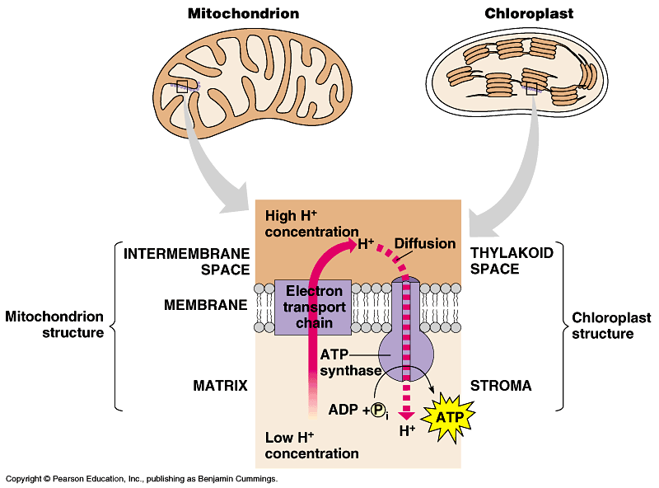
Light reactions
chloroplast
thylakoid
H⁺
H⁺
H⁺
H⁺
H⁺
H⁺
H⁺
H⁺
H⁺
H⁺
H⁺
H⁺
H⁺
H⁺
H⁺
H⁺
ATP
H⁺
H⁺
H⁺
H⁺
H⁺
H⁺
Electron Transport Chain
like in cellular respiration
proteins in organelle membrane
electron acceptors
NADPH
proton (H⁺) gradient across inner membrane
find the double membrane!
ATP synthase enzyme
Notes:
‹#›
Not accidental that these 2 systems are similar, because both derived from the same primitive ancestor.

Slide 74
ETC of Respiration
Mitochondria transfer chemical energy from food molecules into chemical energy of ATP
use electron carrier NADH
generates H₂O
Notes:
‹#›
NADH is an input
ATP is an output
O₂ combines with H⁺’s to form water
Electron is being handed off from one electron carrier to another -- proteins, cytochrome proteins & quinone lipids
So what if it runs in reverse??

Slide 75
ETC of Photosynthesis
Chloroplasts transform light energy into chemical energy of ATP
use electron carrier NADPH
generates O₂
Notes:
‹#›
Two places where light comes in.
Remember photosynthesis is endergonic -- the electron transport chain is driven by light energy.
Need to look at that in more detail on next slide

Slide 76
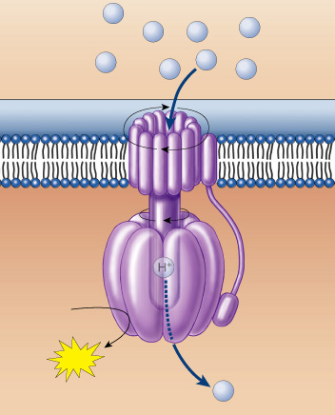
The ATP that “Jack” built
photosynthesis
respiration
sunlight
breakdown of C₆H₁₂O₆
H⁺
H⁺
H⁺
H⁺
H⁺
H⁺
H⁺
H⁺
moves the electrons
runs the pump
pumps the protons
builds the gradient
drives the flow of protons through ATP synthase
bonds P_{i} to ADP
generates the ATP
… that evolution built
ADP + P_{i}
ATP
H⁺
Notes:
‹#›

